Slide 1
BARC Tube Bending Week 1

Slide 2
Statement of the Problem
There is a machine in Boeing manufacturing/processing centres that bends tubes using a rotary draw bending method at a given angle and orientation, but due to the properties of the tubes such as pliability, spring back etc the output bend angle is not always equal to the input bend angle.
To check the bend angle the tube needs to be taken from the machine that bends the tube to another machine that can measure the bend angle. Once the actual angle is measured it is taken back to the machine that bends tubes to make the correction if there is any.
This “post-process” way of checking bend angle greatly reduces efficiency and a way to measure bend angle “in process” is required.

Slide 3
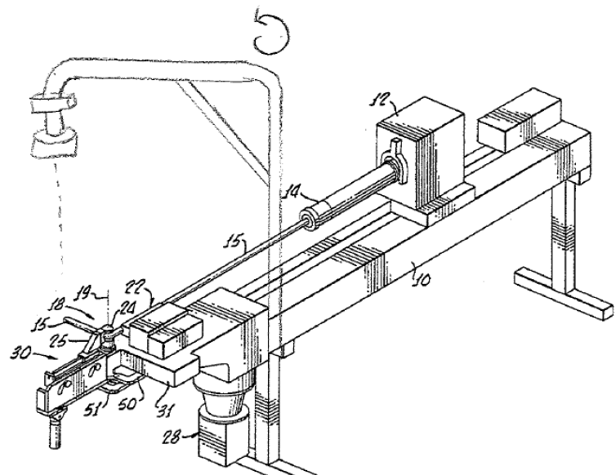
2. Approach to Solution (Overview)
The goal is to come up with a way to measure the bend angle of the tube in process. This measurement has to be quick and have an error of at most 0.05 degrees.
The solution being implemented would look like this in an industrial setting:
Camera
Bend of tube

Slide 4
2. Continued
The machine will be programmed to bend the tube, translate it and pause after each bend.
The camera placed above will then capture each bend individually and from the camera’s image the bend angle will be estimated.
Once the bend angle is estimated the correction input will be given to the machine and the bend angle will be corrected.
Ideally this in process measurement should improve efficiency by approximately 100%.

Slide 5
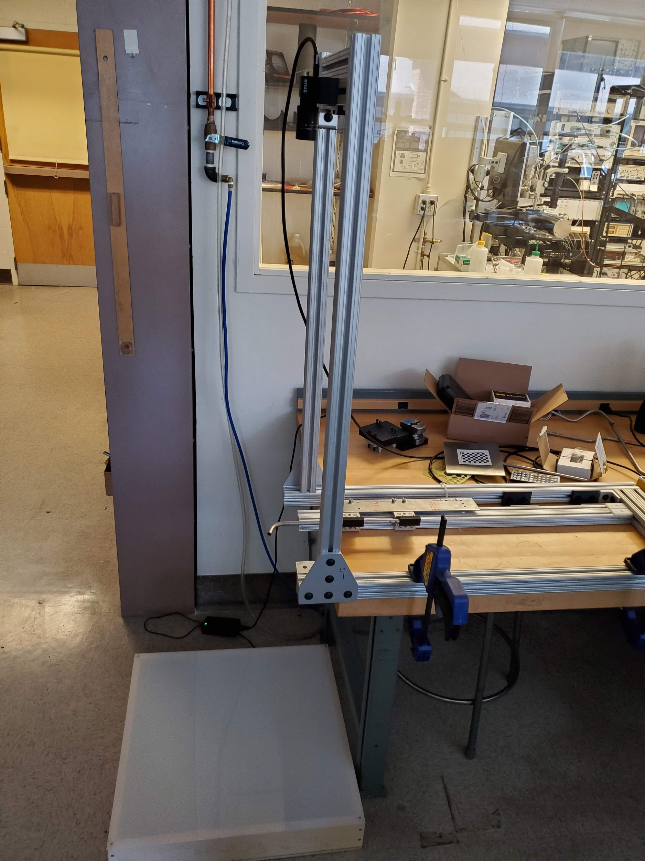
2. Setup
Camera
The setup shown is the idealized version of what would be implemented in a factory setting. Here we can control background lighting and get very clear images.
Bend of Tube
LED box for lighting

Slide 6
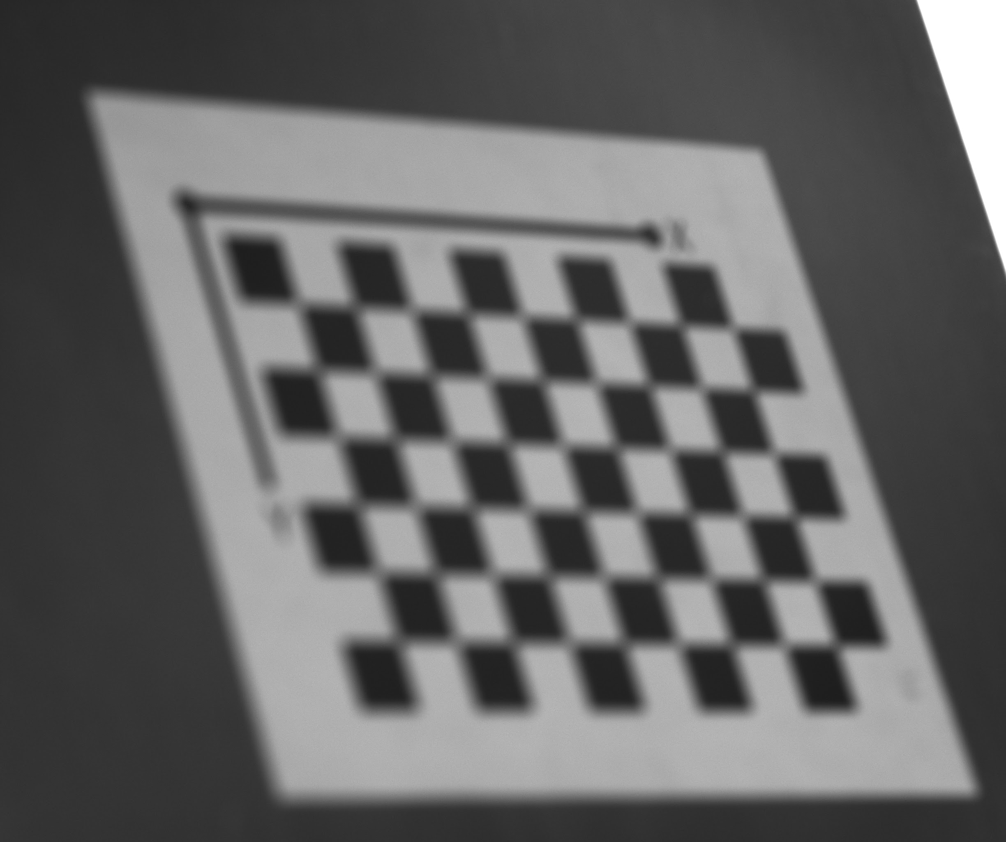
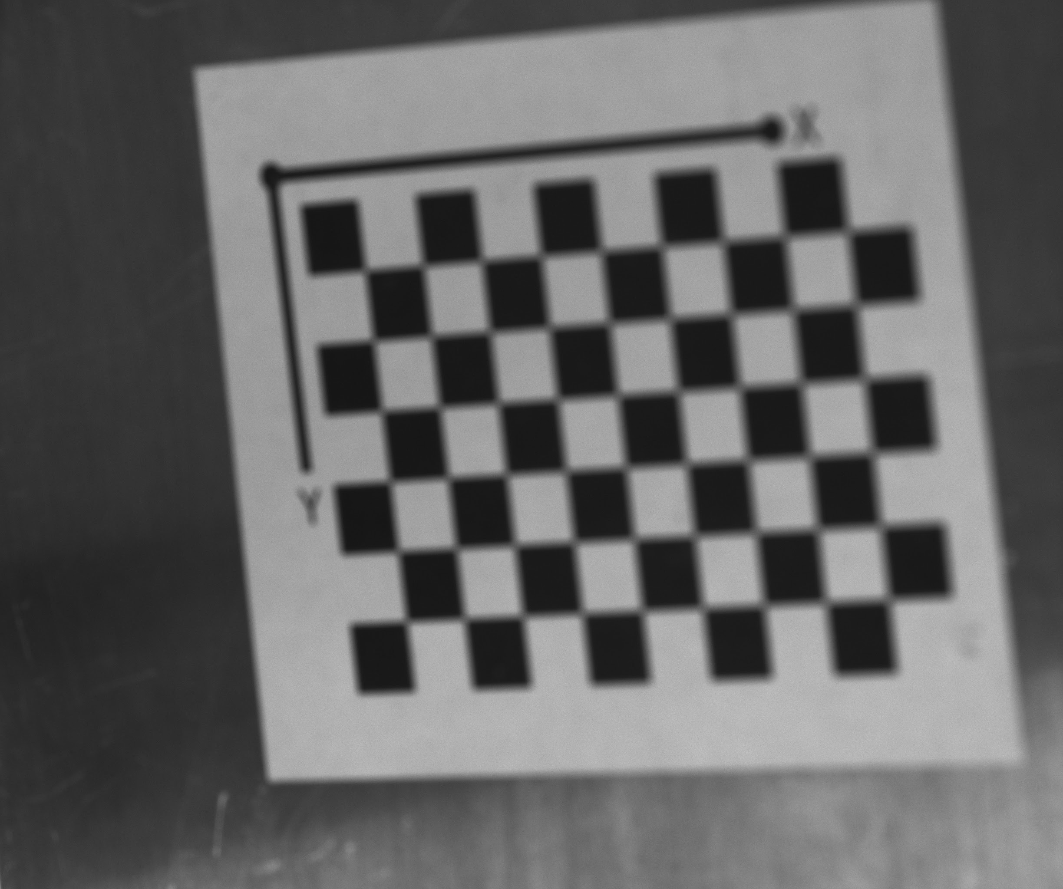
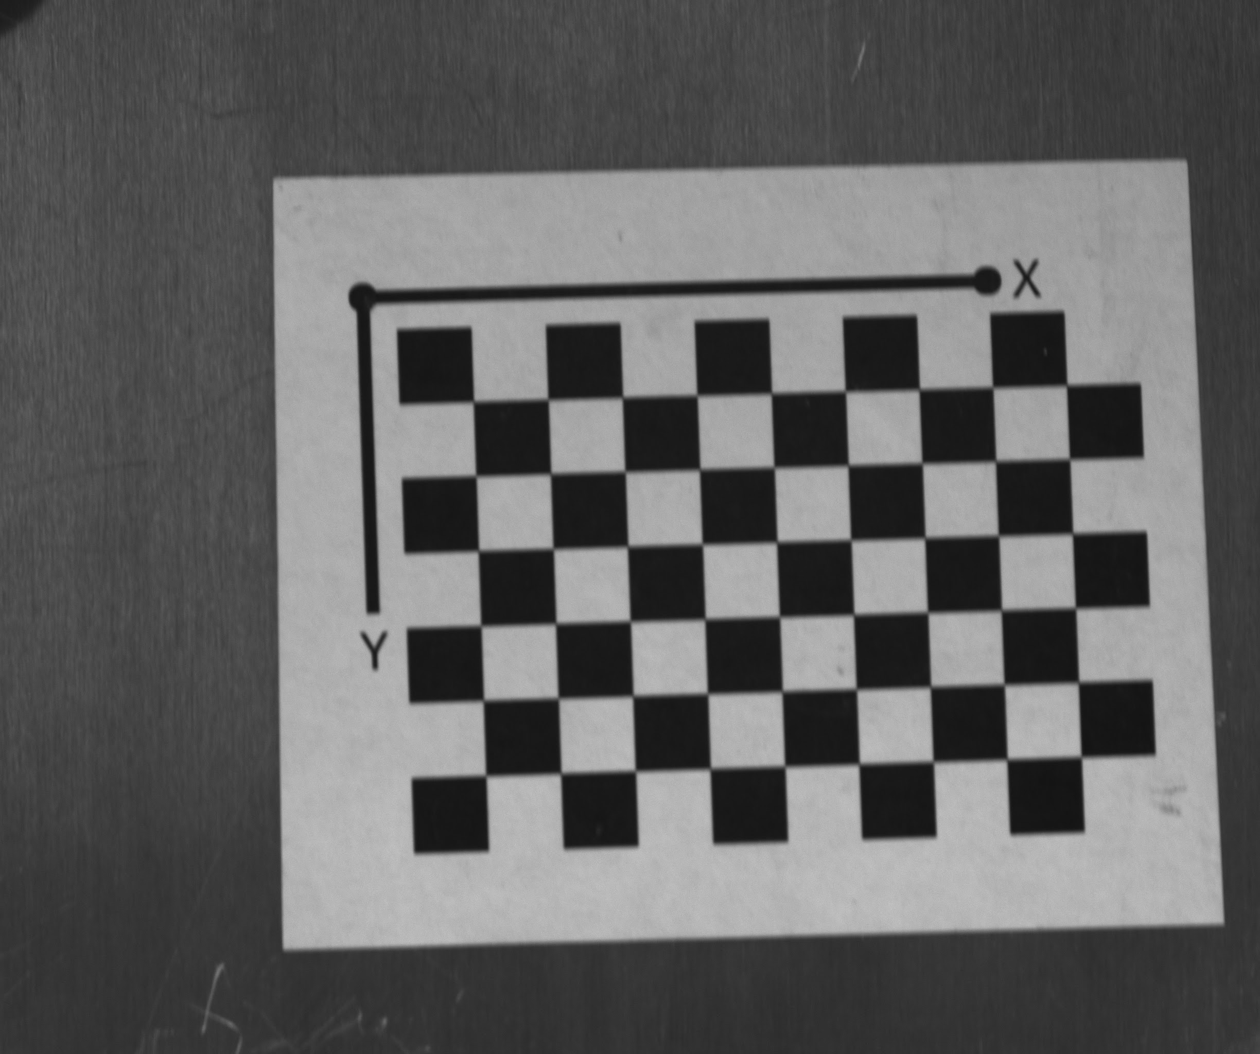
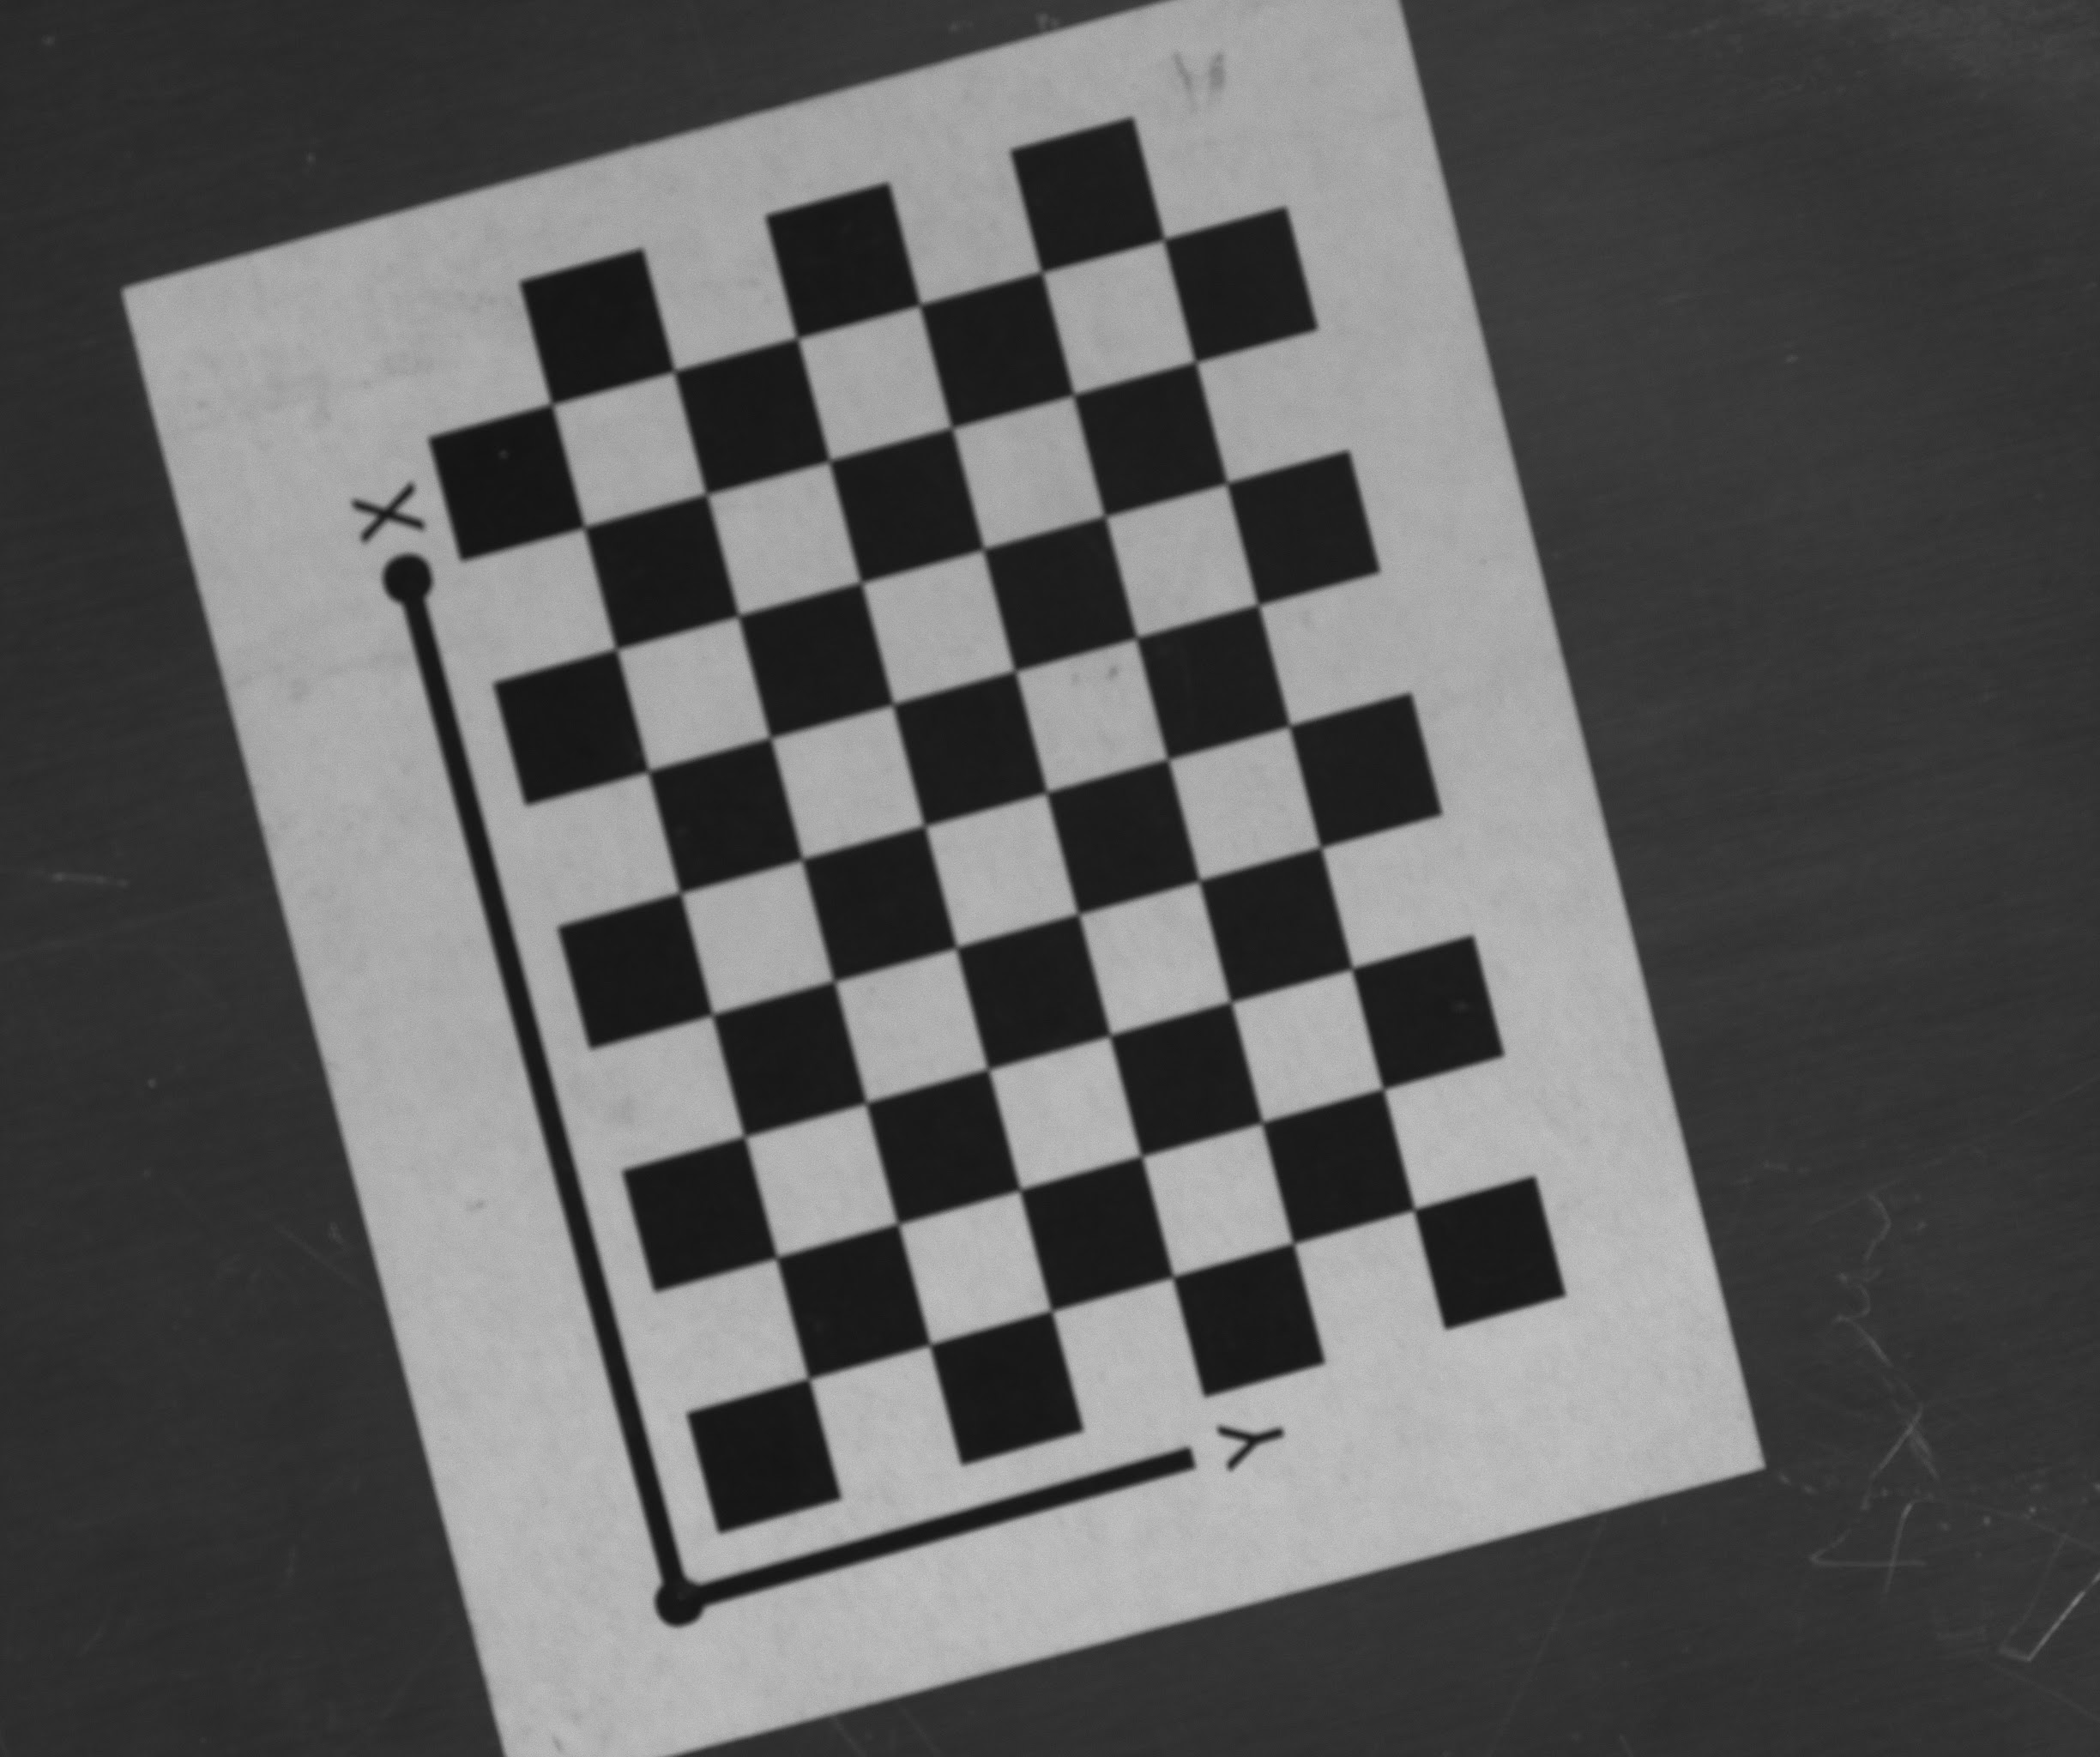
2.1 Camera Calibration
Capturing checker board images using SpinView software and performing calibration in MATLAB to get camera parameters like focal length, principal point etc.
This helps in undistortion of the bend image captured and get a clear picture.
30 such images...

Slide 7
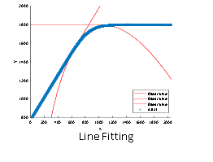
2.2 Centerline algorithm
Obtaining a centreline of the tube to calculate the tangent points. [ Tangent points are points where the angle starts to change]
Perform line fitting at the tangent points and the angle of intersection of the tangent lines will provide the angle of bend.

Slide 8
3. Previous Work
Setup image
Image subtraction
Binarized
Centerline
Line fitting
Tube image

Slide 9

3.1 Centerline with Slicing
After getting the binarized image, do a row/column slicing and average the indices to get the centerline of the tube.
Row Slicing

Slide 10
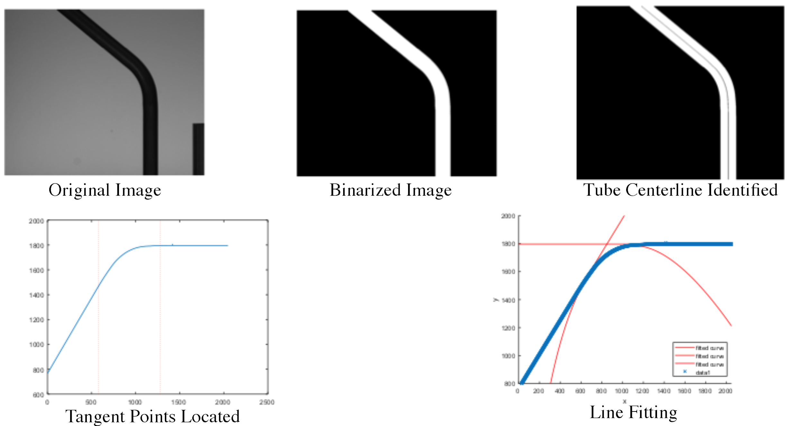
3.2 Successful trial

Slide 11
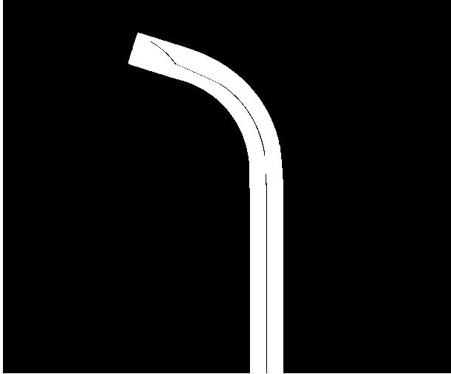

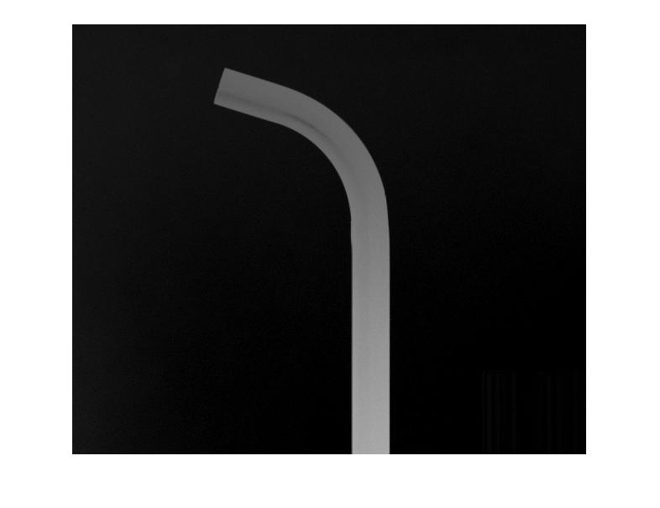
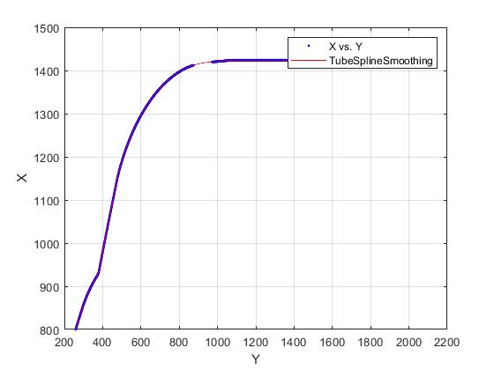
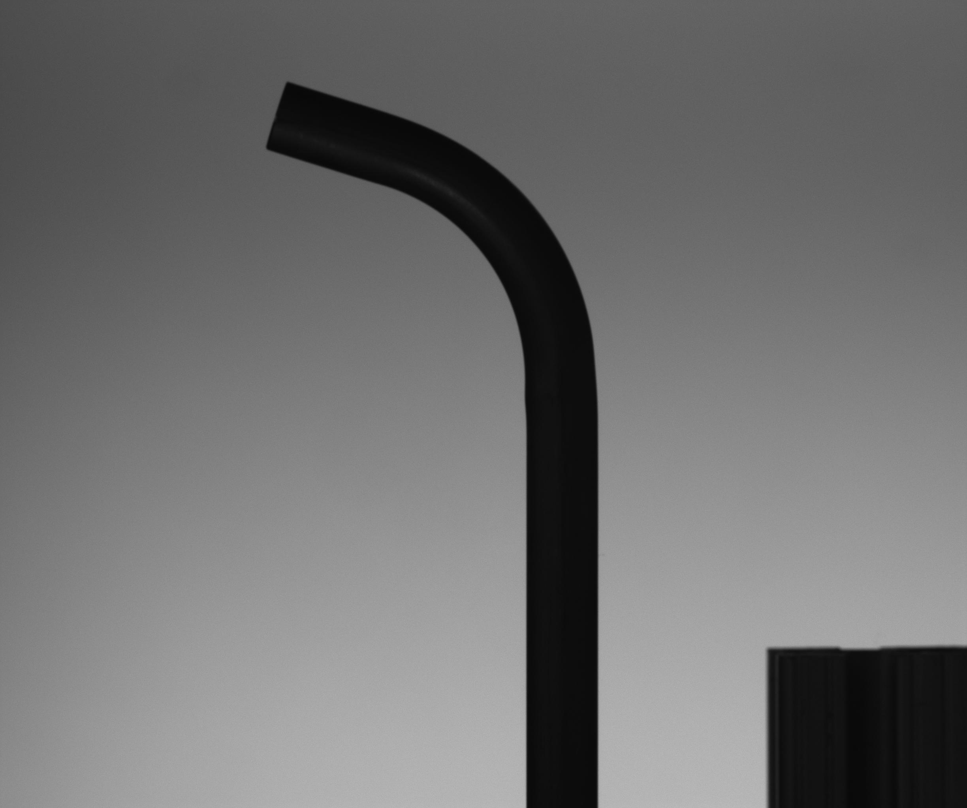
3.3 Unsuccessful trial

Slide 12
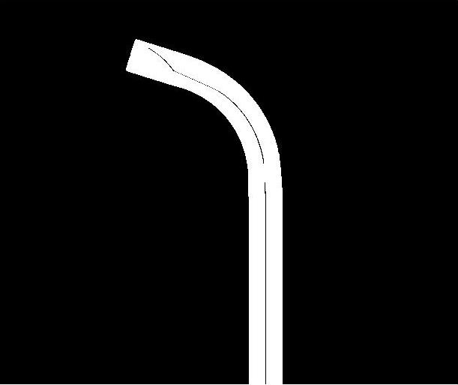
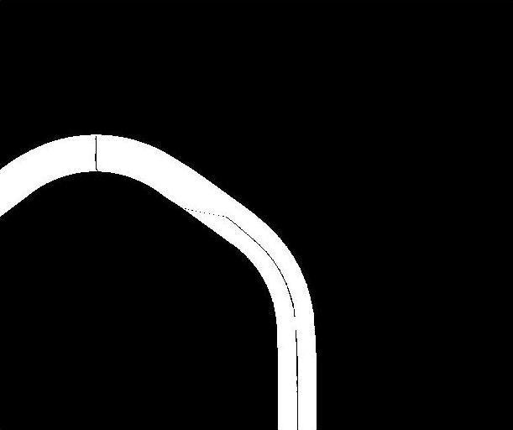
3.3 Slicing error for Part 1
Bend 1
Bend 2

Slide 13
3.3 Insights
Pros:
Straightforward and easy to understand
Fairly small run time
Cons:
Image subtraction is susceptible to environment change
Centerline through slicing approach does not work for multiple bends or large bend angles hence it is not robust and is unreliable.

Slide 14
4. Future Work
Method 1:
Isolate edges of the bend and fit curves to them. After the curve fitting average them to get centerline.
Method 2:
Detect contour of the bend and use a thinning algorithm to detect centerline

Slide 15
4. Continued
Method 3:
Use a sequential least squares algorithm to fit straight lines to the tube. Start from the straight sections of the tube and as a straight line is attempted to fit a curve identify tangent point when error of fit is greater than a threshold.
All the above methods will be done using a single camera under ideal conditions, if the results are not desirable we will consider using multiple cameras.

Slide 16
4. Continued
Once a robust way of finding centerline is obtained we will play with different lighting conditions, changing position of camera(s) and varying tube position.
In the real industrial setting there will be more interference and noise, these will be added once the performance of the CV program is reliable under ideal conditions.

